Slide 1
SMART AI DATA EXTRACTION
Mohammad Khan (D015)

Slide 2


ABOUT CRISIL
CRISIL (formerly Credit Rating Information Services of India Limited) is an Indian analytical company providing ratings, research, and risk and policy advisory services and is a subsidiary of American company S&P Global.

Slide 3
WORKFLOW
Data Collection
Data Augmentation
Modelling
Step 1
Step 2
Step 3
Step 4
Step 5
Data Labelling
Data Preprocessing

Slide 4
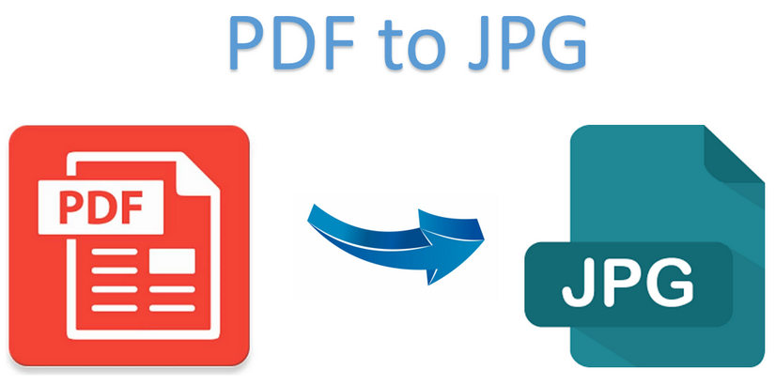
Step 1: DATA COLLECTION
The data was collected from the Business in PDF Format.
These PDF’s were nothing but Financial Reports or Annual Reports of different companies in the Financial Sector.
Within these PDF’s were our Main Objects such as Paragraphs and Tables
But can DATA directly be fetched from PDF’s ?
Obviously not, so we first converted these PDF’s into Images and then extracted our Main Object features from these Images.

Slide 5
Step2: DATA LABELLING
“ Data Labelling also called as data annotation/ tagging, is the process of preparing labelled datasets for machine learning or deep learning models.”

Slide 6
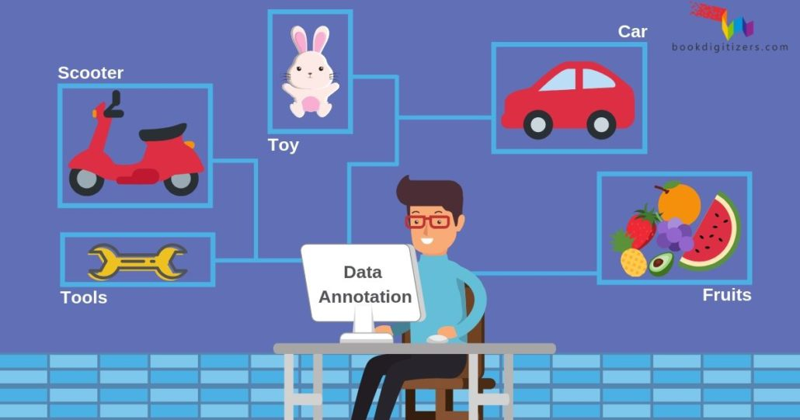
What does it look like ?

Slide 7
Main Objects
Paragraphs
Tables

Slide 8
Step 3: DATA AUGMENTATION
“Data augmentation in data analysis are techniques used to increase the amount of data by adding slightly modified copies of already existing data or newly created synthetic data from existing data. It acts as a regularizer and helps reduce overfitting when training a machine learning model.”

Slide 9
Task 1:
Duplicating Images taking Annotations XML Output with its corresponding as input.
With the XML file we also have to change the text within the file which includes saving the contents of XML file as a string later on after making necessary changes saving them back in .xml format.
Task 2:
Developed a python code which takes a data frame consisting of Address of the Image and other features of the Image.
My task was to write a code which checks if the Image is actually present in the specified folder.
If the Images are not present in the specified folder then dump those similar kind of data rows to another dataframe.

Slide 10
Step 4: DATA PREPROCESSING
Data Cleaning
Label Encoding
Padding
Task 1
Task 2
Task 3
Task 4
Task 5
Oversampling
Tokenization

Slide 11

Step 5: Modelling

Slide 12
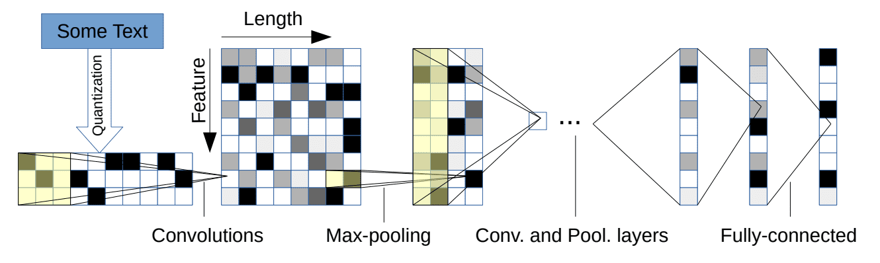
We use the output of the embedding layer applied previously.
Now we add a sequence of Convolutional layers and Max-Pooling layers.
To avoid overfitting we added the use of some regularization techniques such as adding Dropout layers in between.
Finally we flatten those matrices into vectors and add dense layers.
The last dense layer is having 47 as parameter because we are doing a multilabel classification.

Slide 13
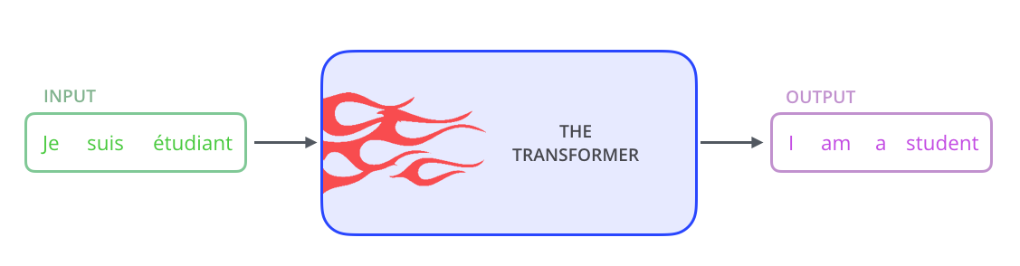
What problems did CNN solve ??
Sequential computation inhibits parallelization
No explicit modeling of long and short range dependencies
“Distance” between positions is linear
Our CNN’s enough ?
The problem is that Convolutional Neural Networks do not necessarily help with the problem of figuring out the problem of dependencies when translating sentences.
That’s why Transformers were created, they are a combination of both CNNs with attention.
Transformer is a model that uses attention to boost the speed. More specifically, it uses self-attention.

Slide 14
LIMITATIONS:
The number of Fields were limited to a certain number.
Different Tabular Structures affected our code for Sentence formation.
FUTURE SCOPES:
Number of fields was limited to a certain number but could be extended in the future.
The Smart AI Extraction can also be used for various different use cases in the Financial Sector.

Slide 15
BIBLIOGRAPHY:
Attention Is All You Need.
Text Classification Based on Convolutional Neural Networks and Word Embedding for Low-Resource Languages: Tigrinya
XLNet: Generalized Autoregressive Pre-training for Language Understanding Presented by Andrew Or, Ksenia Sokolova Zhilin Yang*, Zihang Dai*, Yiming Yang, Jaime Carbonell, Ruslan Salakhutdinov, Quoc V. Le

Slide 16


